Slide 1
Transformer Model

Slide 2










Word Presentation
Next Word Prediction
$$A bird is→flying$$
Training Data
$$flying$$
$$A bird is flying in the sky$$
($A→bird)$
NN
($A bird→is)$
($A bird is→flying)$
($A bird is flying→in)$
…
$$A$$
$$bird$$
$$is$$

Slide 3









Word Presentation
Translator with Next Word Prediction
$$A bird is flying→새가 날고 있다$$
$$날고$$
Training Data
NN
($A bird is flying→새가)$
($A bird is flying 새가→날고)$
($A bird is flying 새가 날고→있다)$
$$A$$
$$bird$$
$$is$$
$$flying$$
$$새가$$
…

Slide 4





Word Presentation
How to Handle Texts
$$(A bird is→flying )$$
$$(A dog is→running)$$
Unique words
$$(A fish→swims)$$
$$…$$
$$…$$
a | an | bird | dong | fish | is | flying | running | swims | …
A
( 1 , 0 , 0 , 0 , 0 , 0 , 0 , 0 , 0 , … )
bird
( 0 , 0 , 1 , 0 , 0 , 0 , 0 , 0 , 0 , … )
is
( 0 , 0 , 0 , 0 , 0 , 1 , 0 , 0 , 0 , … )

Slide 5




Word Representation
How to Handle Texts
$$flying$$
(0,0,0,0,0,0,1,0,0)
NN
(1,0,0,0,0,0,0,0,0)
(0,0,1,0,0,0,0,0,0)
(0,0,0,0,0,1,0,0,0)
$$A$$
$$bird$$
$$is$$

Slide 6



Word Representation
How to Handle Texts
$$flying$$
(0,0,0,0,0,0,1,0,0)
NN
Embedding layer
Embedding layer
Embedding layer
(1,0,0,0,0,0,0,0,0)
(0,0,1,0,0,0,0,0,0)
(0,0,0,0,0,1,0,0,0)
$$A$$
$$bird$$
$$is$$

Slide 7









Word Representation
Representation, Embedding
$$flying$$
$$bird$$
$$flying$$
$$representation$$
$$bird$$
$$A$$
$$is$$
$$A$$
$$is$$
Values in non-Euclidean space
Values in Euclidean space

Slide 8
Attention Mechanism
Overview
Weighted summation
of each input considering context
z
+
X
X
X
s_{i1}
s_{i2}
s_{in}
Softmax
m_{i1}
m_{i2}
m_{in}
Dot Product
Dot Product
Dot Product
query
q
value
x₁
x₂
…
x_{n}
key

Slide 9
Attention Mechanism
How it works
m₁
m₂
m_{n}
Dot Product
Dot Product
Dot Product
query
q
x₁
x₂
…
x_{n}
key

Slide 10
Attention Mechanism
How it works
s₁
s₂
s_{n}
Softmax
m₁
m₂
m_{n}

Slide 11
Attention Mechanism
How it works
z
+
X
X
X
s₁
s₂
s_{n}
value
x₁
x₂
…
x_{n}

Slide 12



Attention Mechanism
$$A\left(x_{i}, X, X\right)$$
How it works:
$$s_{i1}x_{1}+s_{i2}x_{2}+…+s_{in}x_{n}$$
+
X
X
X
s_{i1}
s_{i2}
s_{in}
Softmax
m_{i1}
m_{i2}
m_{in}
Dot Product
Dot Product
Dot Product
$$x_{i}$$
value
x₁
x₂
…
x_{n}
key
$$A\left(x_{i}, X,X\right)=s_{i1}x_{1}+s_{i2}x_{2}+…+s_{in}x_{n}=x_{i}′$$

Slide 13



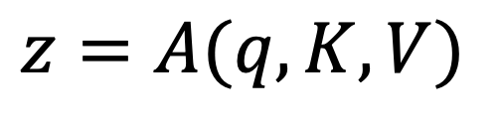





Attention Mechanism
General Form
$$z=A(q, K, V)$$
z
q =
+
$$v_{1}$$
X
X
X
$$v_{2}$$
s₁
s₂
s_{n}
V =
$$…$$
Softmax
$$v_{n}$$
m₁
m₂
m_{n}
Dot Product
Dot Product
Dot Product
$$k_{1}$$
query
K =
$$k_{2}$$
$$…$$
q
$$k_{n}$$
value
v₁
k₁
v₂
k₂
…
v_{n}
k_{n}
key

Slide 14




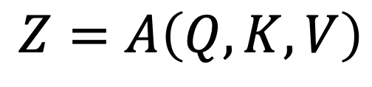













Attention Mechanism
Multiple Queries
$$z_{1}=A\left(q_{1}, K, V\right)$$
$$z_{2}=A\left(q_{2}, K, V\right)$$
$$Z=A\left(Q, K, V\right)$$
$$…$$
$$z_{m}=A\left(q_{m}, K, V\right)$$
$$z_{1}$$
$$q_{1}$$
Z =
$$z_{2}$$
Q =
$$q_{2}$$
$$…$$
$$…$$
$$z_{m}$$
$$q_{m}$$
$$k_{1}$$
$$v_{1}$$
K =
$$k_{2}$$
V =
$$v_{2}$$
$$…$$
$$…$$
$$k_{n}$$
$$v_{n}$$

Slide 15
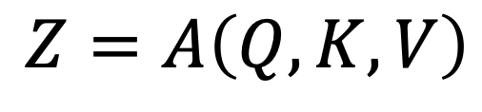
Attention Mechanism
$$Z=A\left(Q, K, V\right)$$
$$z_{1}$$
Z =
$$z_{2}$$
$$…$$
$$z_{m}$$
Attention
$$v_{1}$$
$$k_{1}$$
$$q_{1}$$
$$v_{2}$$
K =
$$k_{2}$$
Q =
$$q_{2}$$
V =
$$…$$
$$…$$
$$…$$
$$v_{n}$$
$$k_{n}$$
$$q_{m}$$

Slide 16
Transformer Overview
It would take a sentence in source language, and output its translation in another.
Input
Generator
Output
Thinking machine learning
기계 학습 생각하기

Slide 17
Transformer Overview
How it works
x₁
x₂
…
x_{n}
o₁
o₂
o₃
o₁
o₂
o₃
Transformer
Neural Network
(Encoder)
Neural Network
(Decoder)
x₁
x₂
…
x_{n}
_{Start}
o₁
o₂

Slide 18
Transformer Overview
Encoder & Decoder
x₁
x₂
…
x_{n}
o₁
O₁
Dense
Encoder
Dense
Decoder
x₁
x₂
…
x_{n}

Slide 19
Transformer Overview
Encoder & Decoder
x₁
x₂
…
x_{n}
o₁
o₂
O₁
O₂
Dense
Encoder
Dense
Decoder
x₁
x₂
…
x_{n}
o₁

Slide 20
Transformer Overview
Encoder & Decoder
x₁
x₂
…
x_{n}
o₁
o₂
o₃
O₁
O₂
O₃
Dense
Encoder
Dense
Decoder
x₁
x₂
…
x_{n}
o₁
o₂

Slide 21
Transformer Overview
Encoder & Decoder
o₁
O₂
O_{t}
??
Generator
Dense
Encoder
Dense
Encoder
x₁
x₂
…
x_{n}
o₁
o₂
…
o_{t}

Slide 22
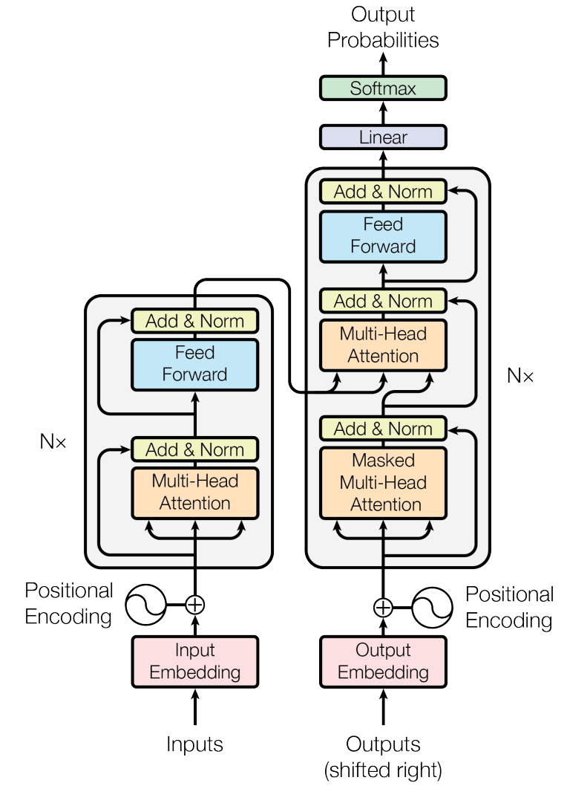
Transformer Overview
Encoder-Decoder approach
Task: machine translation with parallel corpus
Predict each translated word.

Slide 23
Encoder

Slide 24
Encoder Internals
After embedding the words in the input sentence, each of them flows through the two layers of the encoder.
Feed forward
Feed forward
Feed forward
Self-Attention
Thinking
machine
learning

Slide 25
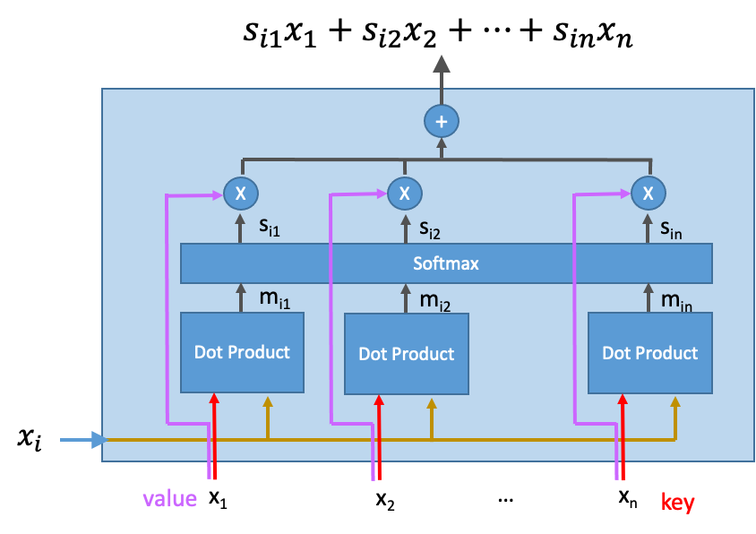










Encoder Internals
Self-Attention Layer in Transformer
Feed forward
Feed forward
Feed forward
$$A\left(x_{1}, X,X\right)$$
$$A\left(x_{2}, X,X\right)$$
$$A\left(x_{3}, X,X\right)$$
Self-Attention
$$x_{1}$$
X =
$$x_{2}$$
$$…$$
$$x_{n}$$
$$x_{1}$$
$$x_{2}$$
$$x_{3}$$

Slide 26
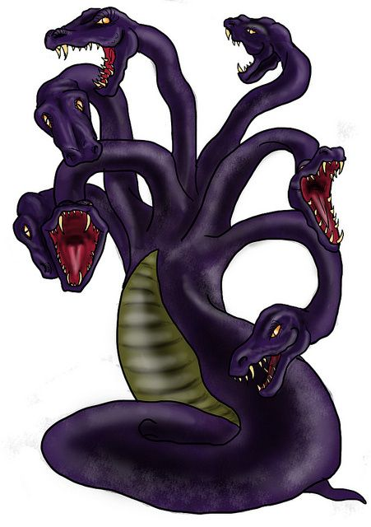
Multi-headed Attention
Refine the self-attention layer by adding a mechanism called “multi-headed” attention.
It expands the model’s ability to focus on different positions.
It gives the attention layer multiple representation subspaces.

Slide 27
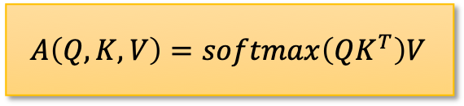

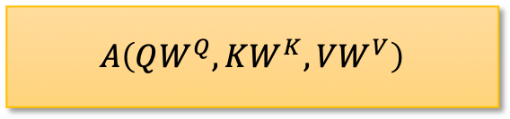
Multi-headed Attention
Attention
$$Q:\left|Q\right|×k, K:\left|K\right|×k, V:\left|V\right|×k$$
What is ‘headed’?
Linear Transformed: $W^{Q}, W^{K}, W^{V} \left(=k×m\right)$
$$A\left(Q, K, V\right)=softmax\left(QK^{T}\right)V$$
$$A\left(QW^{Q}, KW^{K}, VW^{V}\right)$$

Slide 28



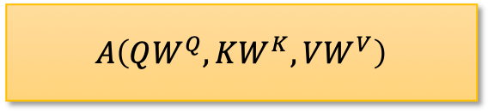


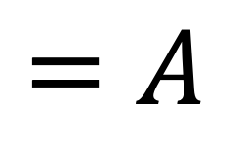

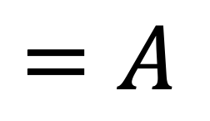
Multi-headed Attention
$$A\left(QW^{Q}, KW^{K}, VW^{V}\right)$$
$$Q$$
$$K$$
$$V$$
$$=A$$
$$QW^{Q}$$
$$KW^{K}$$
$$VW^{V}$$
$$=A$$

Slide 29







Multi-headed Attention
Let’s use multiple heads to capture various similiarities
$$Q$$
$$A\left(QW_{1}^{Q}, KW_{1}^{K}, VW_{1}^{V}\right)=$$
Combine
by linear transform
$$A\left(QW_{2}^{Q}, KW_{2}^{K}, VW_{2}^{V}\right)=$$
$$K$$
$$…$$
$$V$$
$$A\left(QW_{n}^{Q}, KW_{n}^{K}, VW_{n}^{V}\right)=$$

Slide 30








Multi-headed Attention
Let’s use multiple heads to capture various similiarities
$$k$$
$$k$$
$$Z_{1}{ Z}_{2} …{ Z}_{n}$$
$$…$$
$$×$$
$$=$$
$$⋮$$
$$⋮$$
$$⋮$$
Transform matrix

Slide 31



Multi-headed Attention
Let’s use multiple heads to capture various similiarities
$$Q$$
Attention
$$K$$
Multi-Head
Attention
$$V$$

Slide 32
Feed Forward
Point-wise Feed Forward
Feed forward
Feed forward
Feed forward
Multi-Head Attention
Embedding
Input
Thinking
machine
learning

Slide 33
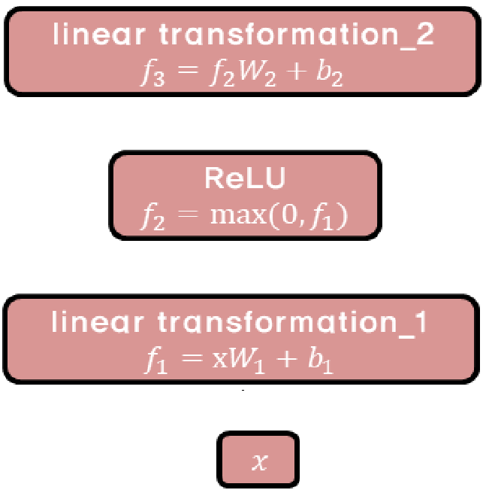
Feed Forward
Point-wise Feed Forward

Slide 34





Positional Encoding
Need to consider the order of the words in the input sentence.
Encoder #1
Encoder #0
Embedding with time signal
$$=$$
$$=$$
$$=$$
Positional encoding
$$+$$
$$+$$
$$+$$
Embedding
Input
Thinking
machine
learning

Slide 35
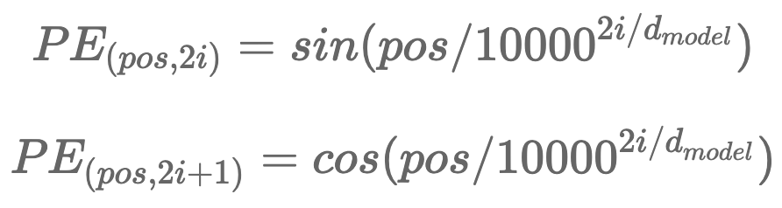






Positional Encoding
Assume that embedding has a dimensionality of 4.
The positional embedding would look like this:
Use cosine and sine curves.
$$<0, 0, 1, 1>$$
$$<0.84, 0.01, 0.54, 1>$$
$$<0.91, 0.01, −0.42, 1>$$
Positional encoding
$$+$$
$$+$$
$$+$$
Embedding
Input
Thinking
machine
learning

Slide 36
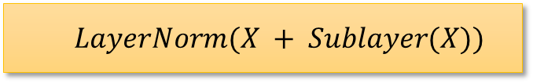
Complete Transformer Block
Each block has two sublayers.
Multi-head attention
2 layer feed-forward net (with relu)
Each of these two steps also has:
Residual (short-circuit) connection and LayerNorm:
Layer normalization
https://arxiv.org/pdf/1607.06450.pdf
$$LayerNorm(X + Sublayer(X))$$

Slide 37
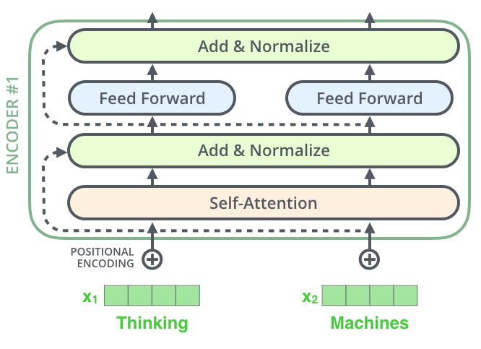
Residual Connection
Each sublayer in each encoder has a residual connection.

Slide 38
Simplified Transformer

Slide 39
Simplified Transformer
갑니다
Linear & Softmax
I go to school 나는 학교에
I go to school 나는 학교에
Cross-
Attention
I go to school
I go to school
I go to school
V
K
Q
I go to school
나는 학교에
나는 학교에
Self-
Attention
Self-
Attention
I
go
to
나는
school
학교에

Slide 40
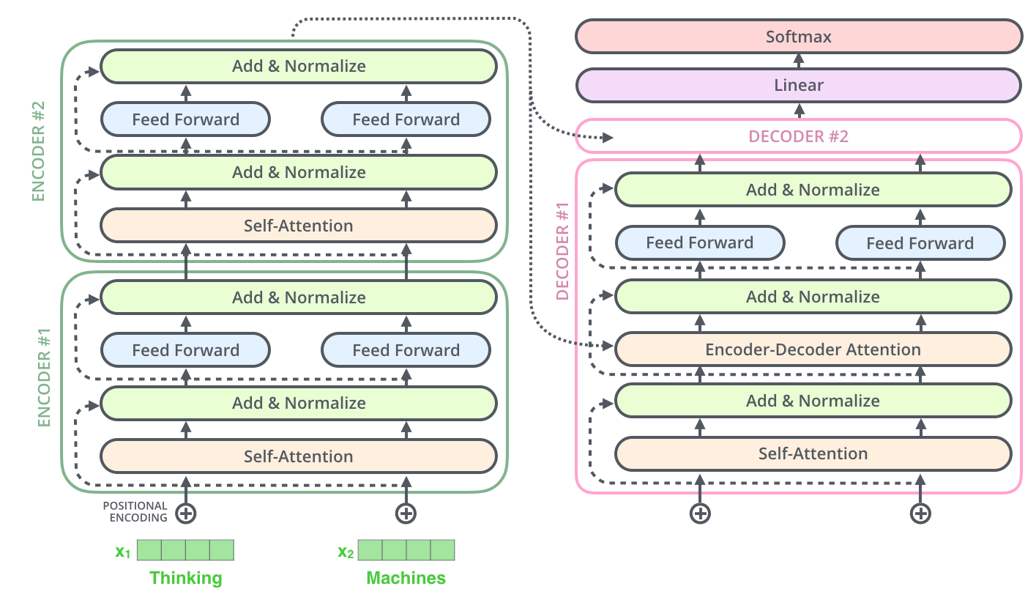
Simplified Transformer
It consists of 2 stacked encoders and decoders.

Slide 41

Decoder: Encoder-Decoder Attention
2 sublayer changes in decoder.
Masked decoder
Self-attention on previously generated outputs is only used.
Encoder-decoder attention
Queries come from previous decoder layer and keys and values come from output of encoder.

Slide 42
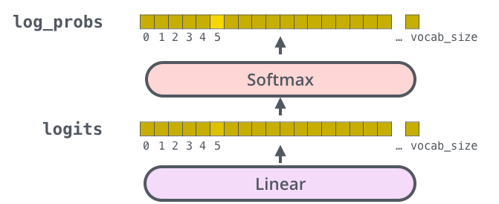
Final Linear and Softmax Layer
The Linear layer is a simple fully connected neural network that projects the vector produced by the stack of decoders, into a much, much larger vector called a logits vector.
The softmax layer then turns those scores into probabilities (all positive, all add up to 1.0).
I go to school 나는 학교에
I go to school 나는 학교에

Slide 43
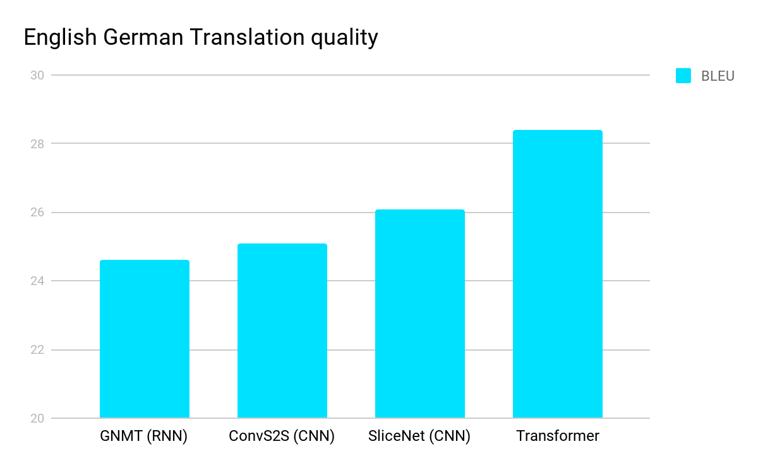
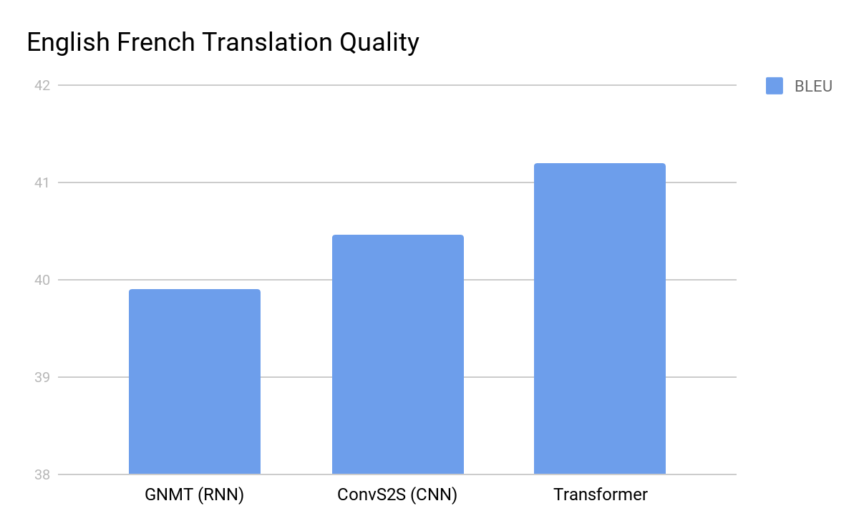
Experimental Results

Slide 44
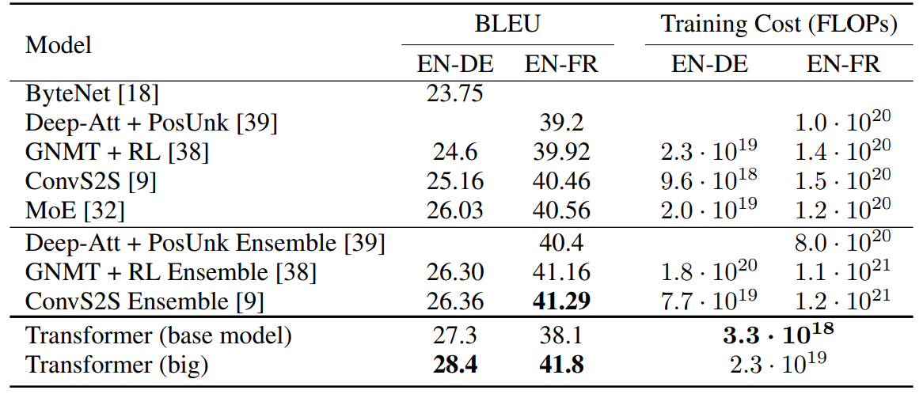
Experimental Results
The Transformer achieves better BLEU scores than the previous model, and training cost is much smaller.

